Slide 1
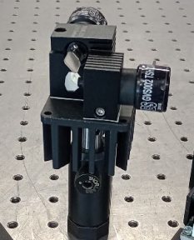
Connection of PCIe express card (DAC) with Galvo-scanner (GVS202)
Mechanical installation : A post adaptor need to fit with the XY mounting block then a lens post is required to fit into the bottom of the post adapter and clamp it to the breadboard which is shown in fig 1.
Electrical Installation
The galvo motor system associated with driver board and connecting cables are tuned at the factory before they are shipped, and further adjustment is not necessary.
During installation, the motors should be connected to the driver card to which they were tuned. Both the motor and the driver card should carry the same serial number.
To power the galvo controller board the linear power supply GPS011 will be used.
For controlling the galvo-scanner, the driver card requires the voltage from -15V to +15V or -18V to +18V, which allows the motor to rotate in both clockwise and counterclockwise direction.
Before powering on, the input voltage range and fuse rating match with the local mains supply should be verified
Fig 1
Lens post
XY mounting block
Post adapter

Slide 2
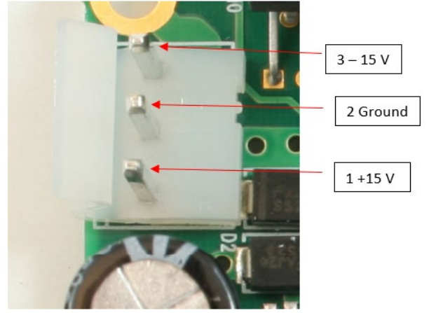
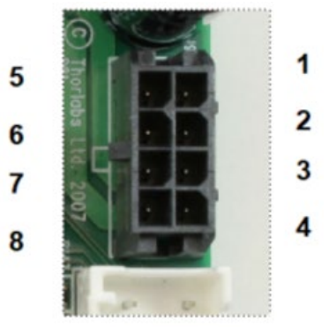
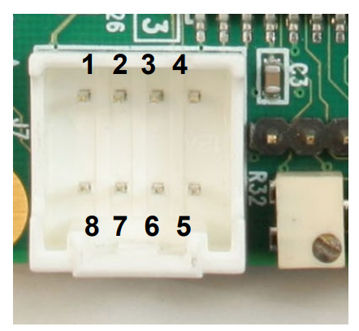
Electrical Connection Procedure
Power connection to the driver board
  Ensure the correct voltage is selected on PSU before connecting it to the driver board.
  Connect the power supply from PSU to J10 power connector on each servo driver board.
  Ensure the correct polarity (+V, GND, −V)
Connection of galvo motor
  The motor cable must be connect to J9 connector on the driver board.
  Each galvo motor must be connect to its corresponding driver board with the same serial number to maintain calibration and performance.
Connection of DAQ device
  The PCIe Data Acquisition (DAQ) card is used to generate the analog control signals for the X- and Y-axis galvanometer scanners.
  The analog output (AO) channels of the PCIe DAQ must be connect to the J7 command input connector of each galvo driver board.
Fig 2(a) J10 pin
Fig 2(b) J9 pin
Fig 2(c) J7

Slide 3
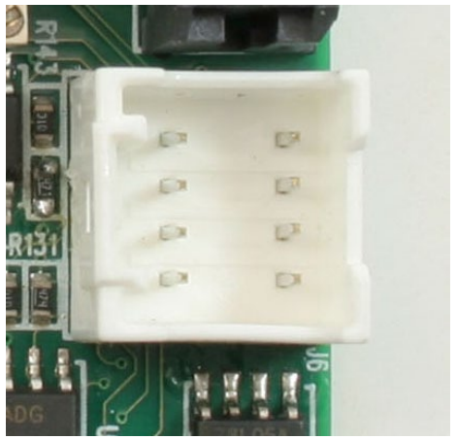
4. Connection for signal monitoring
An oscilloscope is required to connect to J6 connector to observe signals such as mirror
position, position error, motor current and coil voltage during operation. The scanning
mirror position is proportional to the signal voltage, with a scaling factor of 0.5 Volt per
degree of mechanical movement.
Flow Chart of electrical connection
Computer
Fig 3: J6 connector
PCIe DAQ ( maximum voltage provide -10V to +10V, it is command voltage not the voltage to power the motor)
J7
(For 5 deg rotation the PCIe serves 2.5V, calculated from scaling factor )
Servo driver circuit board
GPS011 ( voltage range from -15V to +15V to -18V to +18V)
Local power supply
J10
J9
(Servo driver read this command voltage 2.5V and takes the power from GPS011)
Galvo motor
Mirror reaches +5 deg

Slide 4
Controlling Galvo-scanner with analogue signal using LabVIEW
LabVIEW
Create analog output channel
AO0 X-axis
AO1 Y-axis
Configure DAQ timing using DAQ max timing function
DAQ max timing function determine how often DAQ updates the output voltage
Generate scan waveform
Most preferable
X-axis: Sawtooth Y-axis: Step
Sawtooth waveform for continuous line scanning
Write voltage array to PCIe-DAQ using DAQ max write function
DAQ max write sends data from computer to the NI-DAQ device
PCIe DAQ outputs analog voltage (AO0, AO1)
Servo driver receives command voltage
Reference: https://industrialmonitordirect.com/blogs/knowledgebase/configuring-labview-daqmx-for-galvo-scanner-laser marking

